Slide 1
Graphs of Some Functions

Slide 2

Constant Functions
A function in the form
y = c or f(x) = c
where c is a constant, is called a constant function.
Its domain is all real numbers.
y = 1 and f(x) = −2
are two examples of
constant functions.

Slide 3
Graph of a constant function y = c
The graph of the constant function y = c is a horizontal line, which is parallel to the x-axis.
c > 0
c = 0
c < 0
y
y
y
x
y = 1
y = 0
0
x
x
0
y = −2
0
slope = 0
slope = 0
slope = 0
y-intercept = 1
y-intercept = 0
y-intercept = −2
The y-coordinate of any point on the line is equal to c.

Slide 4

Linear Functions
A function in the form
y = ax + b or f(x) = ax + b
where a and b are constants and a ≠ 0, is called
a linear function of x.
Its domain is all real numbers.
y = 2x − 3 and f(x) = −x + 1
are two examples of
linear functions of x.

Slide 5
Graph of a linear function y = ax + b
The graph of the linear function y = ax + b is a straight line of slope a and y-intercept b.
slope a > 0
slope a < 0
y
y
y = 2x − 3
x
y = −x + 1
-
1-
0
−3 -
-
x
0
1
slope = 2
slope = −1
y-intercept = −3
y-intercept = 1

Slide 6



y
y = ax + b
b
x-intercept
y-intercept
x
0
b
−
a
To sketch the graph of the linear
function y = ax + b, we often find its
x-intercept and y-intercept.

Slide 7
Follow-up question
Sketch the graph of the function y = 2x + 1.
By substituting y = 0 into
y = 2x + 1, we have
The required graph is:
0 = 2x + 1
y
2x = − 1
y = 2x + 1
1
x =
x
∴
The x-intercept is .
0
By substituting x = 0 into
y = 2x + 1, we have
y = 2(0) + 1
= 1
∴
The y-intercept is 1.

Slide 8

Quadratic Functions
A function in the form
y = ax² + bx + c or f(x) = ax² + bx + c
where a, b and c are constants and a ≠ 0, is called
a quadratic function of x.
Its domain is all
real numbers.
By completing the square, any quadratic function
y = ax² + bx + c can be converted into the form
y = a(x − h)² + k.
y = 2x² + x and f(x) = –x²
are two examples of
quadratic functions of x.

Slide 9
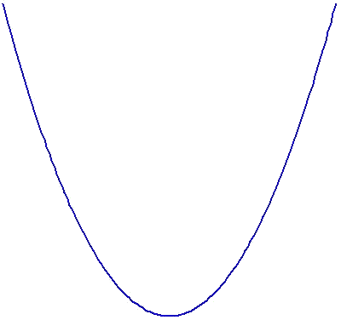
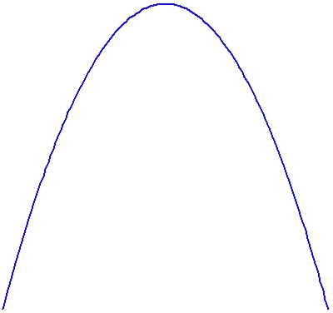
Graph of a quadratic function y = ax² + bx + c
The graph of y = ax² + bx + c (or y = a(x − h)² + k) is in the shape of a parabola.
a > 0
a < 0
opens upwards
y
axis of symmetry
vertex
y
y = ax² + bx + c
(h, k)
x = h
y-intercept
─ c
x
x
0
0
c ─
y = ax² + bx + c
x = h
(h, k)
vertex
axis of symmetry
y-intercept
opens downwards

Slide 10

a > 0
a < 0
y
opens upwards
y
y = ax² + bx + c
(h, k)
x = h
y = ax² + bx + c
c
x
x
0
x₁
x₂
x₃
0
x₄
c
x = h
(h, k)
opens downwards
In sketching the graph of the quadratic function
y = ax² + bx + c (or y = a(x − h)² + k),
we have to find:
1. Direction of opening
4. y-intercept
2. Axis of symmetry
5. x-intercept(s)
3. Coordinates of the vertex
of the graph.

Slide 11
Follow-up question
Sketch the graph of the function y = (x + 3)² – 4.
The required graph is:
∵ Coefficient of x² = 1 > 0
y
∴ The graph opens upwards.
x = −3
The axis of symmetry: x = −3
5
The coordinates of the vertex: (−3, −4)
By substituting x = 0 into y = (x + 3)² – 4,
we have
x
−5
−1
0
∴
The y-intercept is 5.
(−3, −4)
By substituting y = 0 into y = (x + 3)² – 4,
we have
0 = (x + 3)² – 4
x + 3 = −2 or x + 3 = 2
x = −5 or x = −1
∴
The x-intercepts are −5 and −1.

Slide 12
Exponential Functions
A function in the form
y = a^{x} or f(x) = a^{x}
Its domain is all real numbers.
where a > 0 and a ≠ 1, is called an exponential function.
y = 3^{x} and are
two examples of
exponential functions of x.

Slide 13


Graph of an exponential function y = a^{x}
a > 1
0 < a < 1
y
The graphs lie above the
x-axis
y
y = a^{x}
(0, 1)
y = a^{x}
(0, 1)
x
x
0
0
The graphs cut the
y-axis at (0, 1).

Slide 14

y
y = a^{x}
1 -
x
0
and
Note that the graphs of y = a^{x}
show reflectional symmetry with each other
about the y-axis.

Slide 15
Logarithmic Functions
A function in the form
Since a logarithmic function is
undefined when x ≤ 0, its domain
is all positive real numbers.
where a > 0 and a ≠ 1, is called an logarithmic function.
y = log₂ x and are
two examples of
logarithmic functions of x.

Slide 16

Graph of a logarithmic function y = log_{a} x
a > 1
0 < a < 1
y
y
y = log_{a} x
The graphs lie on the right hand side of the y-axis
(1, 0)
x
x
0
(1, 0)
0
y = log_{a} x
The graphs cut the
x-axis at (1, 0).

Slide 17
y
y = log_{a} x
x
0
1
The graphs of y = log_{a} x
and
show reflectional symmetry with each
other about the x-axis.

Slide 18
y
y
y = log_{a} x
1
y = a^{x}
x
x
0
1
0
1
y = x
y = log_{a} x
The graphs of y = a^{x}
and y = log_{a} x
show reflectional symmetry with each
other about the line y = x.

Slide 19

Trigonometric Functions
For any angle θ, a function in the form
(a) y = sin θ or f(θ ) = sin θ is called a sine function;
(b) y = cos θ or f(θ ) = cos θ is called a cosine function;
(c) y = tan θ or f(θ ) = tan θ is called a tangent function.
In general, they are called
trigonometric functions.

Slide 20
Graph of y = sin θ
y
maximum value
1
y = sin θ
θ
−720°
−630°
−540°
−450°
−360°
−270°
−180°
−90°
0
90°
180°
270°
360°
450°
540°
630°
720°
− 1
minimum value
y = sin θ is a periodic function with period 360°.
i.e. their graphs repeat themselves every 360°.
The domain of the sine function is all real numbers.

Slide 21
Graph of y = cos θ
y
maximum value
1
y = cos θ
θ
−720°
−630°
−540°
−450°
−360°
−270°
−180°
−90°
0
90°
180°
270°
360°
450°
540°
630°
720°
− 1
minimum value
y = cos θ is a periodic function with period 360°.
i.e. their graphs repeat themselves every 360°.
The domain of the cosine function is all real numbers.

Slide 22
Graph of y = tan θ
y
y = tan θ
10
θ
−720°
−630°
−540°
−450°
−360°
−270°
−180°
−90°
0
90°
180°
270°
360°
450°
540°
630°
720°
− 10
tan θ has neither a maximum nor a minimum value.
y = tan θ is a periodic function with period 180°.
i.e. their graphs repeat themselves every 180°.
The domain of the tangent function is all real numbers except ±90°, ±270°, ±450°, ±630°, etc.

Slide 23
In summary, we have
 | Domain | Periodic function | Existence of max. or min. value
Linear function
Quadratic function
Exponential function
Logarithmic function
Sine function
Cosine function
Tangent function
All real numbers
No
No
All real numbers
No
Yes
All real numbers
No
No
All positive real numbers
No
No
All real numbers
Yes (period = 360°)
Yes
All real numbers
Yes (period = 360°)
Yes
All real numbers, except ±90°, ±270°, etc.
Yes (period = 180°)
No

Slide 24
Follow-up question
Consider the graphs of the functions y = (x – 1)² and y = log₂ x.
y
y
y = (x – 1)²
y = log₂ x
x
x
0
0
(a) Complete the following table.
Function | y = (x – 1)² | y = log₂ x
Domain
Maximum or minimum value
Periodic function
All real numbers
All positive real numbers
Minimum value
= 0
Not exist
No
No

Slide 25
Follow-up question
Consider the graphs of the functions y = (x – 1)² and y = log₂ x.
y
y
y = (x – 1)²
y = log₂ x
x
x
0
0
(b) Which graph(s) has/have reflectional symmetry? State the axis of symmetry of each symmetric graph.
The graph of y = (x – 1)² has reflectional symmetry.
The axis of symmetry is x = 1.

